Slide 1
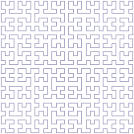

Space-Filling
Curves
An Introduction
Presented by Levi Valgaerts
JASS 2005 Saint Petersburg

Slide 2
Contents
Introductory section
Types of space-filling curves
  The Hilbert space-filling curve
  The Peano space-filling curve
  The Sierpinski space-filling curve
  The Lebesgue space-filling curve
Application of space-filling curves
JASS 2005 Saint Petersburg

Slide 3
Contents
Introductory section
Types of space-filling curves
  The Hilbert space-filling curve
  The Peano space-filling curve
  The Sierpinski space-filling curve
  The Lebesgue space-filling curve
Application of space-filling curves
JASS 2005 Saint Petersburg

Slide 4
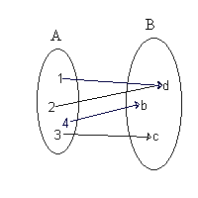
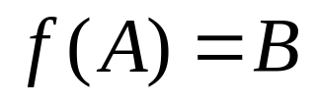
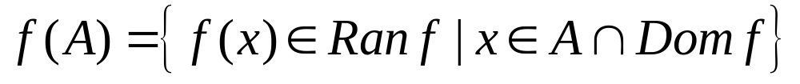
Basic concepts from set theory: surjective, injective, bijective mapping
Surjective map from A onto B:
with
the image of A under the function f
JASS 2005 Saint Petersburg

Slide 5
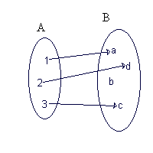
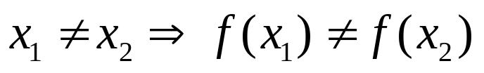
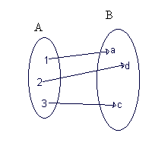
Basic concepts from set theory: surjective, injective, bijective mapping
Injective map from A into B:
Bijective map from A onto B:
f is injective and surjective
JASS 2005 Saint Petersburg

Slide 6


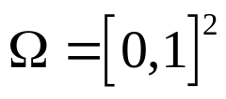
Basic notations
Subsets of : ,
Binary notation:
Ternary notation:
Quaternary notation:
JASS 2005 Saint Petersburg

Slide 7
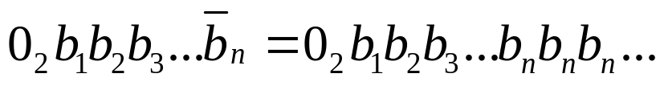
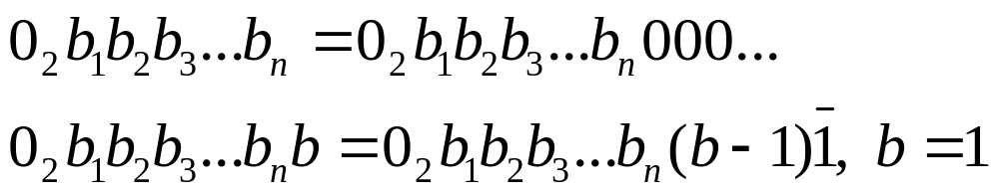
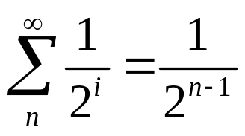
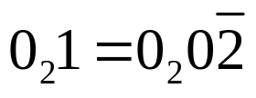
Basic notations (remarks)
Periods
Finite binaries
e.g. because
JASS 2005 Saint Petersburg

Slide 8
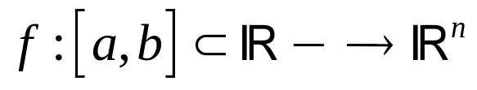
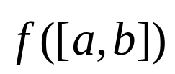

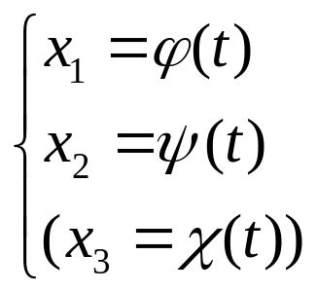
Curve definition
If is continuous, then
is called a curve. Without loss of generality we can assume the
domain to be I, f(0) and f(1) are the beginning and endpoint.
Notation:
Parameter representation with component functions:
JASS 2005 Saint Petersburg

Slide 9


Space-filling curve (SFC) definition
A space-filling curve is a curve whose range reaches every point in a higher dimensional region, typically the unit square
Curves that pass through every point of an n-dimensional region with positive area (for n=2) or volume (for n=3), such as the unit square Ω in or the unit cube in , are called space-filling curves.
Two main characteristics:
  continuous
  surjective
It can be shown that if f generates a space-filling curve, then it can not be bijective.
JASS 2005 Saint Petersburg

Slide 10
Contents
Introductory section
Types of space-filling curves
  The Hilbert space-filling curve
  The Peano space-filling curve
  The Sierpinski space-filling curve
  The Lebesgue space-filling curve
Application of space-filling curves
JASS 2005 Saint Petersburg

Slide 11
Contents
Introductory section
Types of space-filling curves
  The Hilbert space-filling curve
  The Peano space-filling curve
  The Sierpinski space-filling curve
  The Lebesgue space-filling curve
Application of space-filling curves
JASS 2005 Saint Petersburg

Slide 12

The Hilbert curve: geometric generation
If I can be mapped continuously on Ω, then after partitioning I into four congruent subintervals and Ω into four congruent subsquares, each subinterval can be mapped continuously onto one of the subsquares. This partitioning can be carried out ad infinitum.
The subsquares must be arranged such that adjacent subintervals are mapped onto adjacent subsquares.
Inclusion relationship: if an interval corresponds to a square, then its subintervals must correspond to the subsquares of that square.
This process defines a mapping , called the Hilbert space-filling curve.
JASS 2005 Saint Petersburg

Slide 13
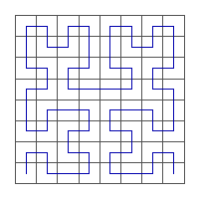
The Hilbert curve: geometric generation
¹/₄
²/₄
³/₄
⁴/₄
0
1
¹/₁₆
²/₁₆
³/₁₆
⁴/₁₆
1,1
¹⁶/₁₆
1,1
2
3
4
3
1
4
1
2
16
0,0
0,0
1st iteration
2nd iteration
3rd iteration
JASS 2005 Saint Petersburg

Slide 14
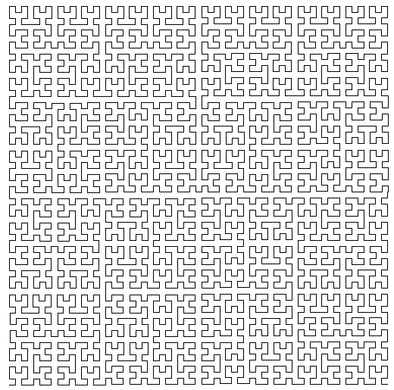
The Hilbert curve: geometric generation
6th iteration
JASS 2005 Saint Petersburg

Slide 15
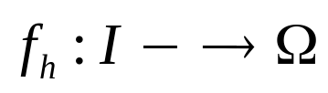

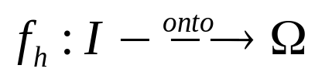

The Hilbert curve: geometric generation
The mapping is surjective: with every sequence of nested closed squares corresponds a sequence of nested closed intervals that define a unique .
The mapping is continuous: in the nth iteration I is partitioned in subintervals, thus
The mapping is nowhere differentiable.
JASS 2005 Saint Petersburg

Slide 16

The Hilbert curve: a complex representation [Sagan]
Establish a formula to calculate the exact coordinates of an image point if
Use complex representation , and affine transforma-tions to wich Ω will be subjected recursively.
Give an orientation to each subsquare such that the exit point of a subsquare coincides with the entry point of the next subsquare.
JASS 2005 Saint Petersburg

Slide 17



The Hilbert curve: a complex representation
0
1
0
1
0
1
0th iteration
1st iteration
2nd iteration
JASS 2005 Saint Petersburg

Slide 18
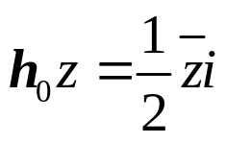
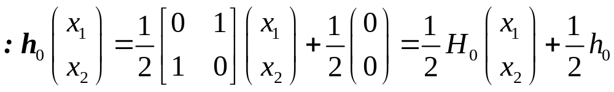
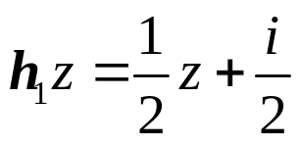
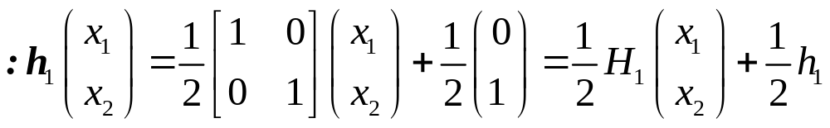
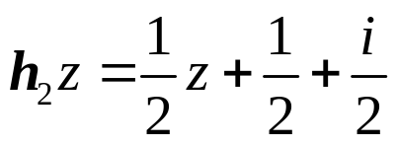
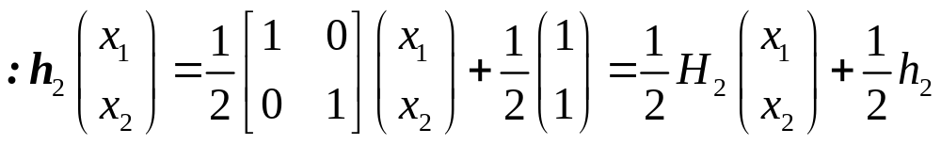
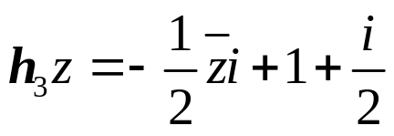
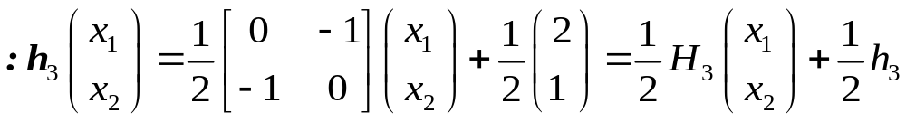
The Hilbert curve: a complex representation
The four basic transformations (2 dimensional case):
JASS 2005 Saint Petersburg

Slide 19

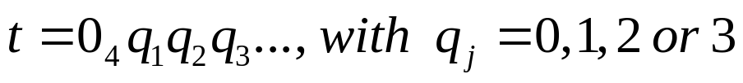
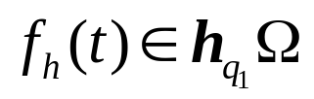
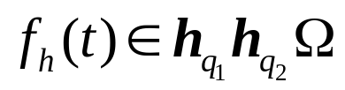
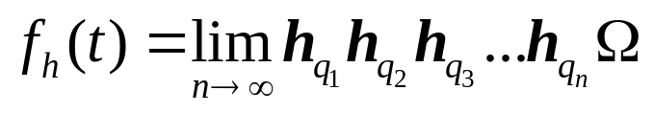
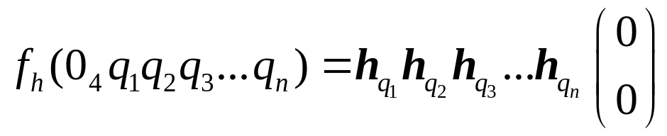
The Hilbert curve: a complex representation
Represent as
, , ad infinitum:
For finite quaternaries (edges of subintervals in nth iteration):
JASS 2005 Saint Petersburg

Slide 20
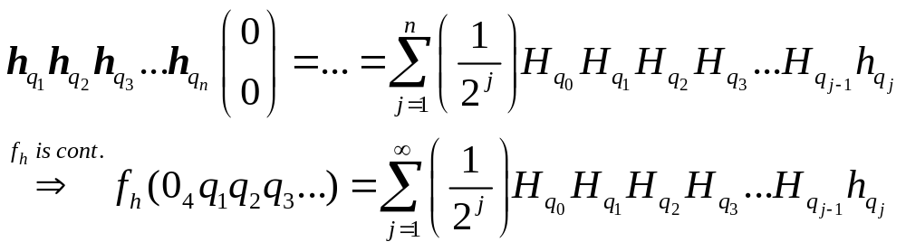
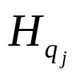
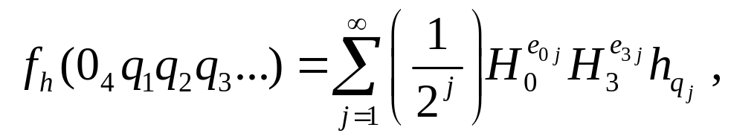
The Hilbert curve: a complex representation
continued...
Taking into account some properties of :
JASS 2005 Saint Petersburg

Slide 21
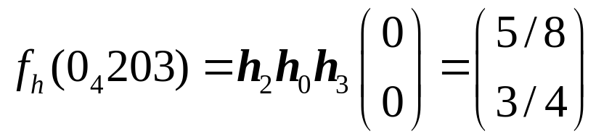




The Hilbert curve: a complex representation
Further simplifications of the formula are possible...
An example:
(0,0)
JASS 2005 Saint Petersburg

Slide 22
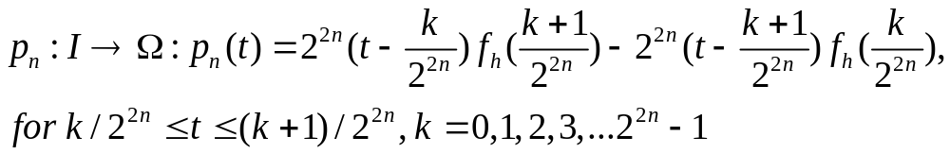

Approximating polygons for the Hilbert curve
The polygonal line that runs through the points
is called the nth approximating polygon or a discrete space filling curve.
Parametrization:
converges uniformly to the Hilbert curve
JASS 2005 Saint Petersburg

Slide 23
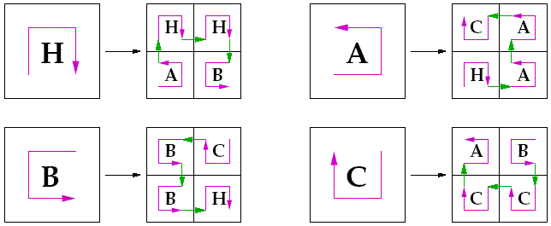
The Hilbert curve: representation through grammars
Make use of four distinct templates to generate the discrete Hilbert curve: H,A,B and C.
These templates will be translated to a first iteration of the curve according to a fixed scheme.
JASS 2005 Saint Petersburg

Slide 24
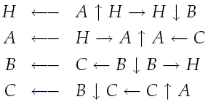
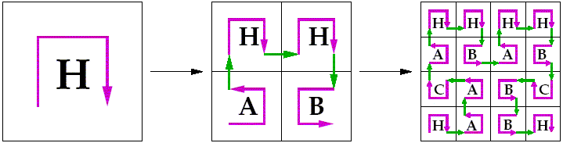
The Hilbert curve: representation through grammars
The resulting rules and transitions can be used to implement the recursive construction of the discrete Hilbert curve.
JASS 2005 Saint Petersburg

Slide 25
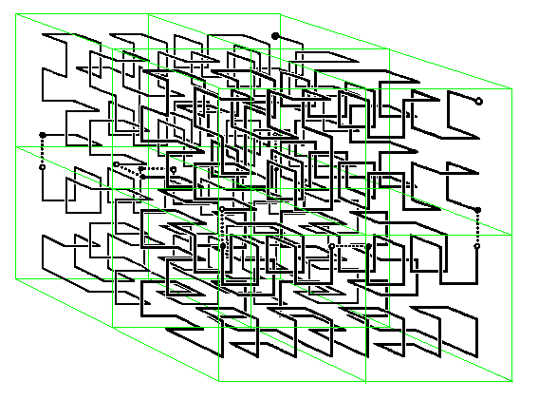
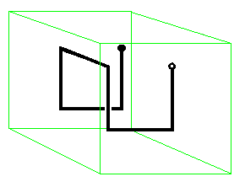
3 dimensional SFCs
JASS 2005 Saint Petersburg

Slide 26
Contents
Introductory section
Types of space-filling curves
  The Hilbert space-filling curve
  The Peano space-filling curve
  The Sierpinski space-filling curve
  The Lebesgue space-filling curve
Application of space-filling curves
JASS 2005 Saint Petersburg

Slide 27
Contents
Introductory section
Types of space-filling curves
  The Hilbert space-filling curve
  The Peano space-filling curve
  The Sierpinski space-filling curve
  The Lebesgue space-filling curve
Application of space-filling curves
JASS 2005 Saint Petersburg

Slide 28
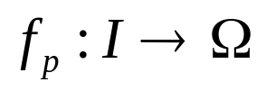
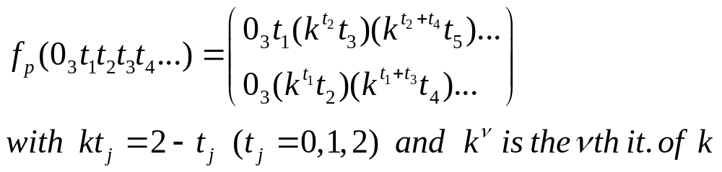
The Peano curve: definition
with
is surjective and continuous on I, and represents a SFC.
More interesting: geometric generation according to Hilbert
JASS 2005 Saint Petersburg

Slide 29
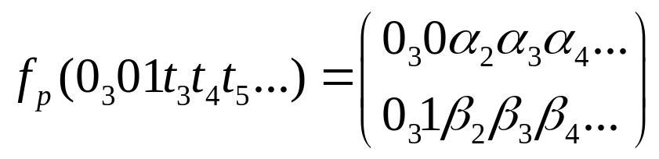

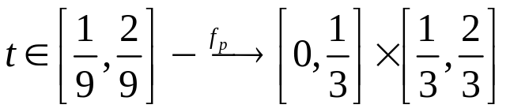
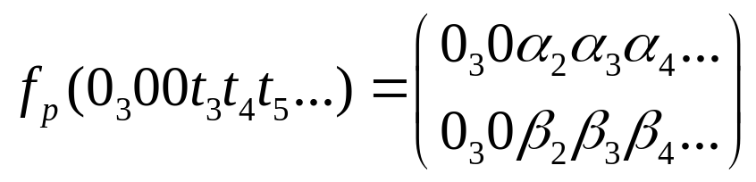

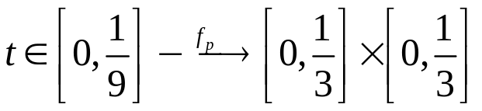
The Peano curve: geometric generation
From the defining formula we can derive:
...
1
3
4
9
2
5
8
1
6
7
0
1
JASS 2005 Saint Petersburg

Slide 30


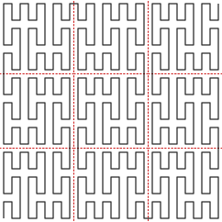
The Peano curve: geometric generation
1st iteration
2nd iteration
3rd iteration
JASS 2005 Saint Petersburg

Slide 31
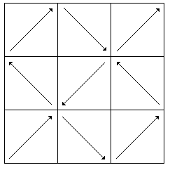


The Peano curve: a complex representation
Define orientation of the subsquares:
Define similarity transforms:
with
JASS 2005 Saint Petersburg

Slide 32

The Peano curve: a complex representation
Use ternary representation of :
Continue as with Hilbert´s curve...
→ we get the same result as in Peano´s definition
JASS 2005 Saint Petersburg

Slide 33


Approximating polygons for the Peano curve
JASS 2005 Saint Petersburg

Slide 34



The Peano curve: representation through grammars
JASS 2005 Saint Petersburg

Slide 35
Contents
Introductory section
Types of space-filling curves
  The Hilbert space-filling curve
  The Peano space-filling curve
  The Sierpinski space-filling curve
  The Lebesgue space-filling curve
Application of space-filling curves
JASS 2005 Saint Petersburg

Slide 36
Contents
Introductory section
Types of space-filling curves
  The Hilbert space-filling curve
  The Peano space-filling curve
  The Sierpinski space-filling curve
  The Lebesgue space-filling curve
Application of space-filling curves
JASS 2005 Saint Petersburg

Slide 37






The Sierpinski curve: generation
Originaly defined as a map from I onto , but it can be considered as a map from I onto a right isosceles triangle .
JASS 2005 Saint Petersburg

Slide 38





The Sierpinski curve: generation
Partition I into congruent subintervals and into congruent subtriangles.
In deriving an algabraic representation it is easier to divide I into subintervals, thus using quaternaries:
τ
n=0
n=1
n=2
JASS 2005 Saint Petersburg

Slide 39


The Sierpinski curve: generation
with similarity transforms:
JASS 2005 Saint Petersburg

Slide 40



The Sierpinski curve: generation
Taking into account some properties of :
JASS 2005 Saint Petersburg

Slide 41

The Sierpinski curve: approximating polygons
τ
n=0
n=1
n=2
n=3
JASS 2005 Saint Petersburg

Slide 42
Contents
Introductory section
Types of space-filling curves
  The Hilbert space-filling curve
  The Peano space-filling curve
  The Sierpinski space-filling curve
  The Lebesgue space-filling curve
Application of space-filling curves
JASS 2005 Saint Petersburg

Slide 43
Contents
Introductory section
Types of space-filling curves
  The Hilbert space-filling curve
  The Peano space-filling curve
  The Sierpinski space-filling curve
  The Lebesgue space-filling curve
Application of space-filling curves
JASS 2005 Saint Petersburg

Slide 44



The Lebesgue curve: introduction
Introduction of a remarkable subset of I, the Cantor Set
,of wich all elements can be
represented by
may be constructed by recursively removing the middle third of every closed subinterval beginning with I. The numbers that are generated in this proces do not contain a 1 in their ternary representation.
JASS 2005 Saint Petersburg

Slide 45










The Lebesgue curve: introduction
...
JASS 2005 Saint Petersburg

Slide 46






The Lebesgue curve: definition
We define the continuous and surjective mapping
and extend f continuously into I by linear interpolation in every interval that is removed in the generation of :
with removed in the nth iteration step. Further we say
on . Than defines the Lebesgue space-filling curve.
JASS 2005 Saint Petersburg

Slide 47


The Lebesgue curve: generation and approxima-ting polygons
1st iteration
2nd iteration
4th iteration
JASS 2005 Saint Petersburg

Slide 48
Contents
Introductory section
Types of space-filling curves
  The Hilbert space-filling curve
  The Peano space-filling curve
  The Sierpinski space-filling curve
  The Lebesgue space-filling curve
Application of space-filling curves
JASS 2005 Saint Petersburg

Slide 49
Contents
Introductory section
Types of space-filling curves
  The Hilbert space-filling curve
  The Peano space-filling curve
  The Sierpinski space-filling curve
  The Lebesgue space-filling curve
Application of space-filling curves
JASS 2005 Saint Petersburg

Slide 50
Application of space-filling curves
2 dimensional SFCs give a recipe for going through a set of 2 dimensional data that are arranged on a grid:
going through pixels that make up an image being scanned
matrix operations in linear algebra
going through / representing a 2D computational grid
...
Favorable property: better exploitation of the 2D locality due to the recursive nature / self-similarity.
JASS 2005 Saint Petersburg

Slide 51
Application of space-filling curves
Representation of computational grids (1)
Acceptable computational complexity is required in implemen-ting computational grids. Especially for adaptively refined grids the manipulation part cannot be too expensive → choice of ap-propriate data structures is important.
Often applied: space trees of which the leaves correspond to the grid cells that are enumerated by a discrete SFC. For adaptively refined grids we use different iterates depending on the level of refinement.
JASS 2005 Saint Petersburg

Slide 52


Application of space-filling curves
Representation of computational grids (2)
JASS 2005 Saint Petersburg

Slide 53
Application of space-filling curves
Implementation with respect to cache-efficiency (1)
Data access of hierarchically stored data can be slow. By using SFC we try to process the data linearly in a way that reduces data access time and cache misses.
Build a fixed number of stacks to avoid random access in the memory, such that data (information in a grid point) needed in the operation sequence is always on top. The corresponding processing order of the grid cells is defined by a SFC.
JASS 2005 Saint Petersburg

Slide 54


Application of space-filling curves
Implementation with respect to cache-efficiency (2)
Use of two stacks with a Peano curve on a 2D regular grid
JASS 2005 Saint Petersburg

Slide 55
Application of space-filling curves
Implementation with respect to cache-efficiency (3)
Consequences:
Memory behaviour becomes deterministic and processing order is easily inverted.
The discrete operator has to be decomposed per cell such that the accumulated effect corresponds to the execution of the whole operator after one run over all cells.
JASS 2005 Saint Petersburg

Slide 56
Application of space-filling curves
Grid partitioning and parallellisation (1)
For running a PDE solver on a parallel computer we need to partition the data and map each block to a processor such that data transfer between the processors is as small as possible.
Multi-dimensional data can be mapped to a one-dimensional sequence using the inverse of a discrete SFC mapping. The points on I that are the images of nodes in space can be grouped together and mapped on a processor. We use seperators to form partitions that contain the same number of nodes for perfect load balance.
JASS 2005 Saint Petersburg

Slide 57






Application of space-filling curves
Grid partitioning and parallellisation (2)
Set of points:
where of equal workload, gives small seperators \
, in fact quasi-optimal seperator sizes where other partition methods fail.
JASS 2005 Saint Petersburg

Slide 58
List of references
[1] Hans Sagan, Space-Filling Curves, Springer-Verlag, 1994.
[2] Michael Bader, Raumfüllende Kurven, Institut für Informatik
der Technischen Universität München, 2004.
[3] F. Günther, M. Mehl, M. Pögl, C. Zenger, A cache-aware
algorithm for PDEs on hierarchical data structures based on
space-filling curves.
[4] Gerhard Zumbusch, Adaptive Parallel Multilevel Methods for
Partial Differential Equations.
[5] R. Dafner, D. Cohen-Or, Y. Matias, Context-based Space
Filling Curves, 2000.
[6] www.wikipedia.org
JASS 2005 Saint Petersburg

